Slide 1
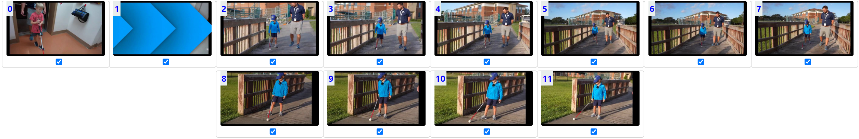

Slide 2
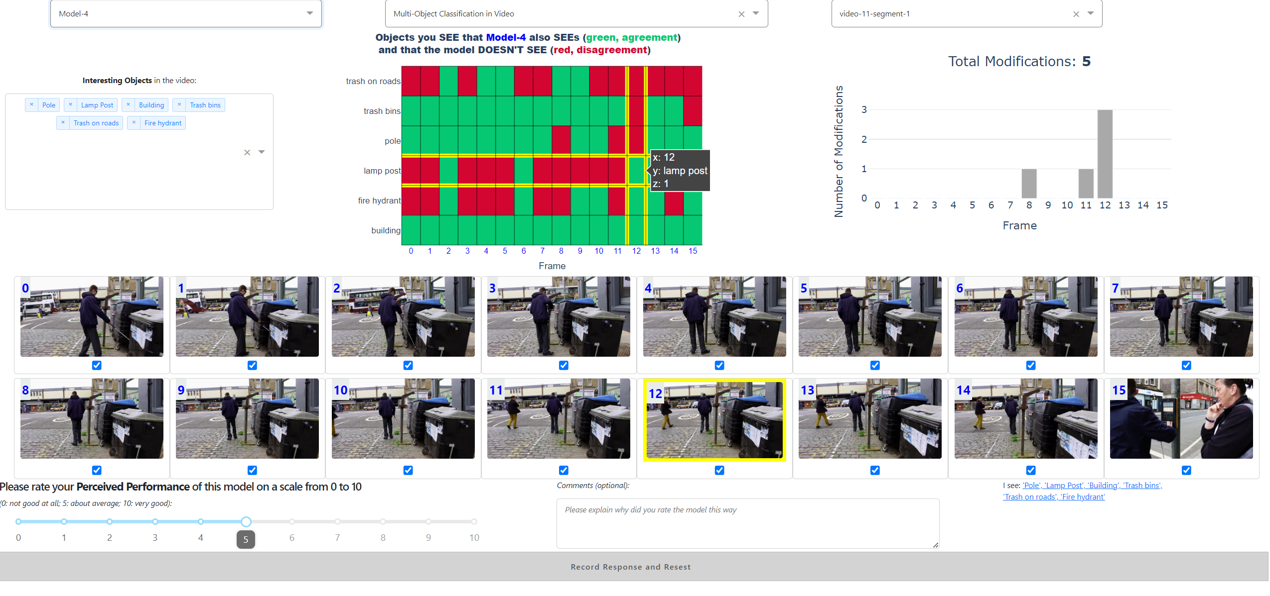

Slide 3
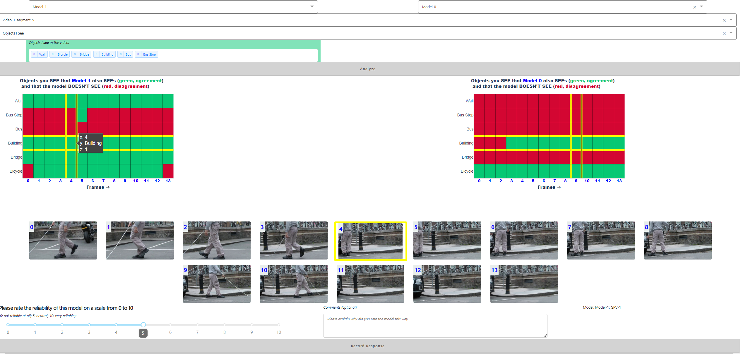

Slide 4
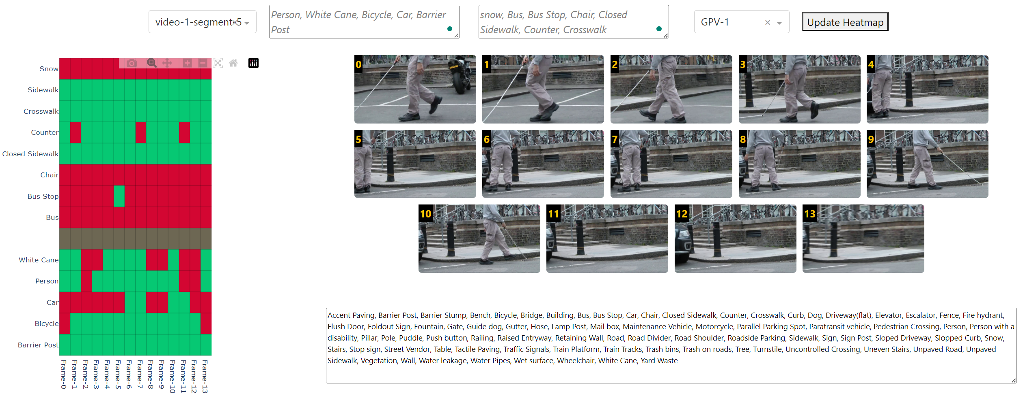

Slide 5
20
15
10
5
0
1
2
3
4
5
6
7
8
9
10

Slide 6
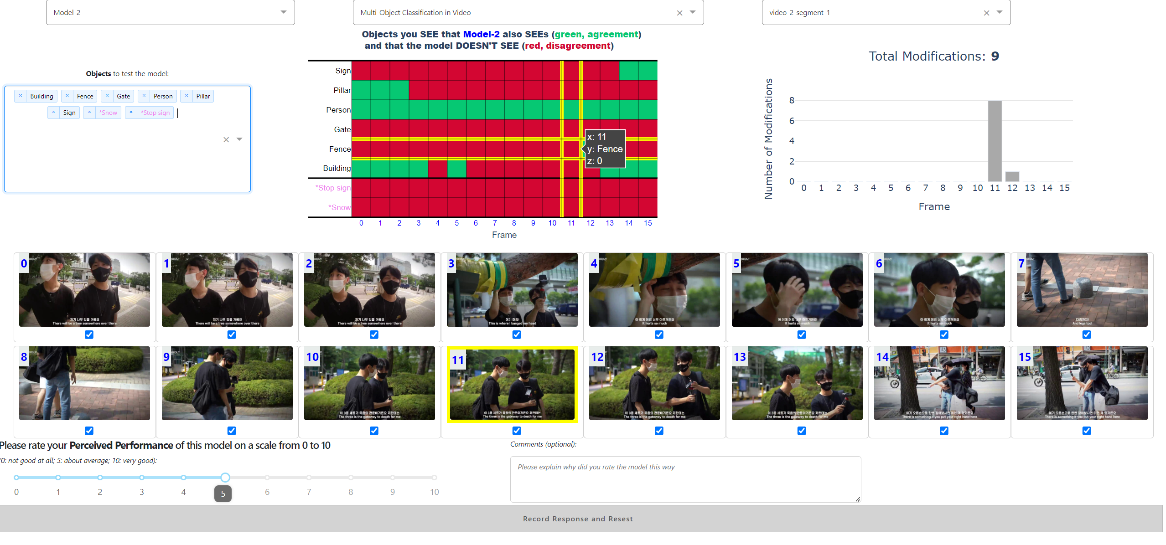

Slide 7
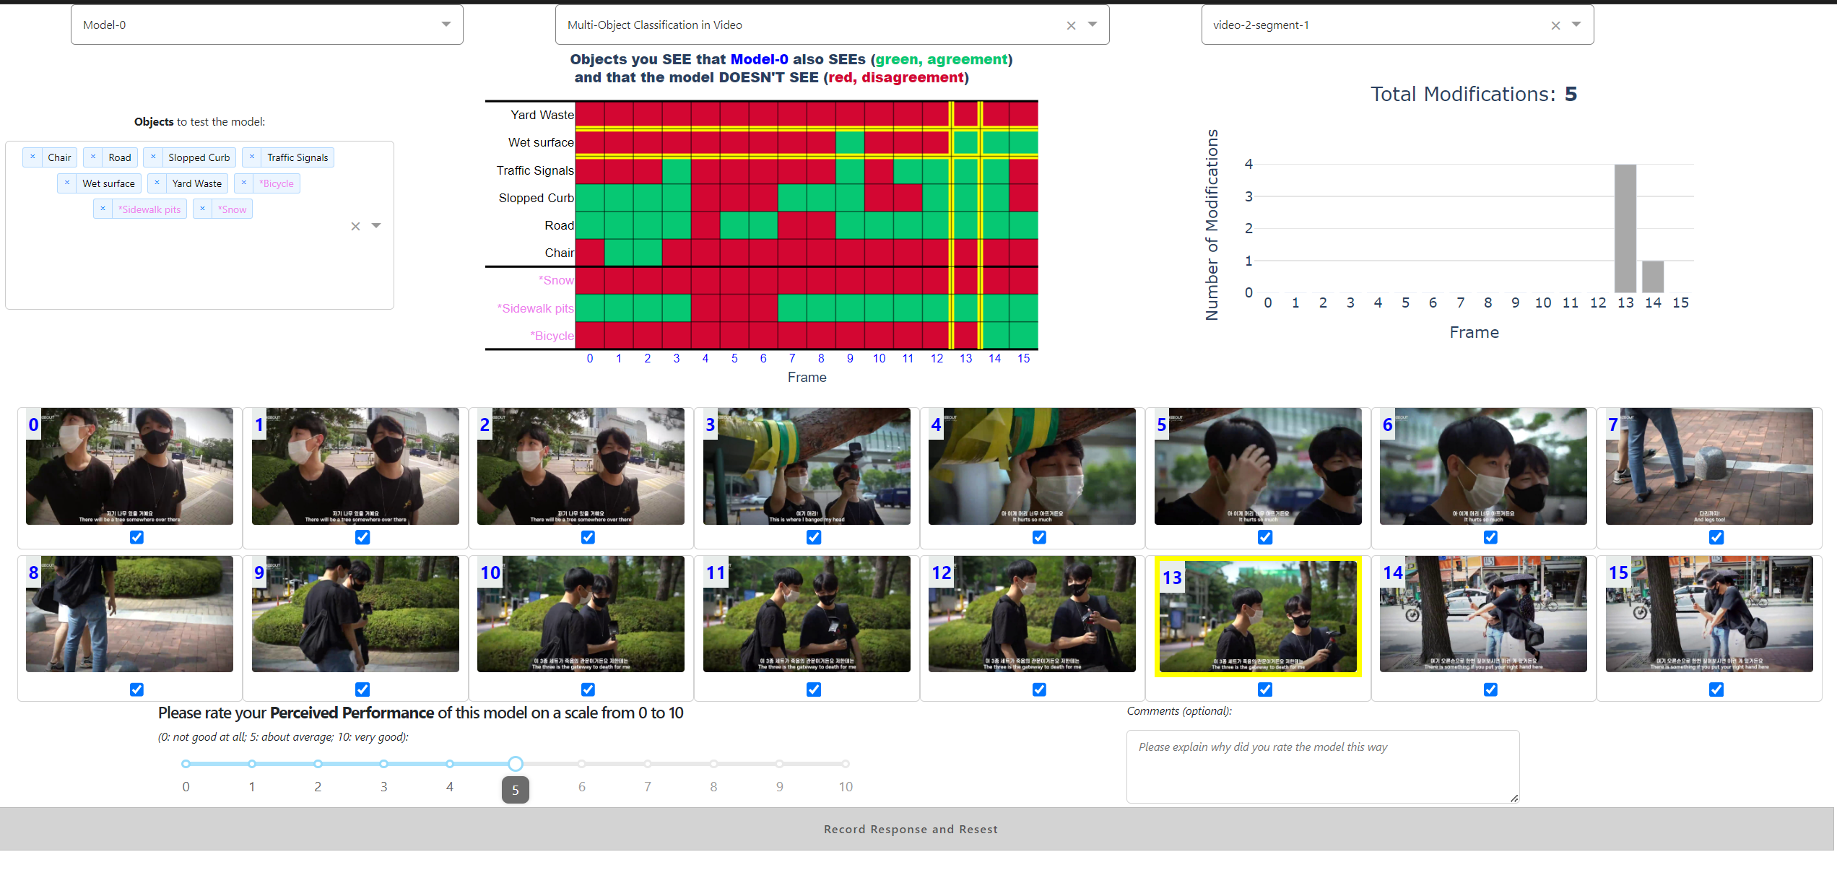

Slide 8
A
B
C
F
E
D
G
H
I
J

Slide 9
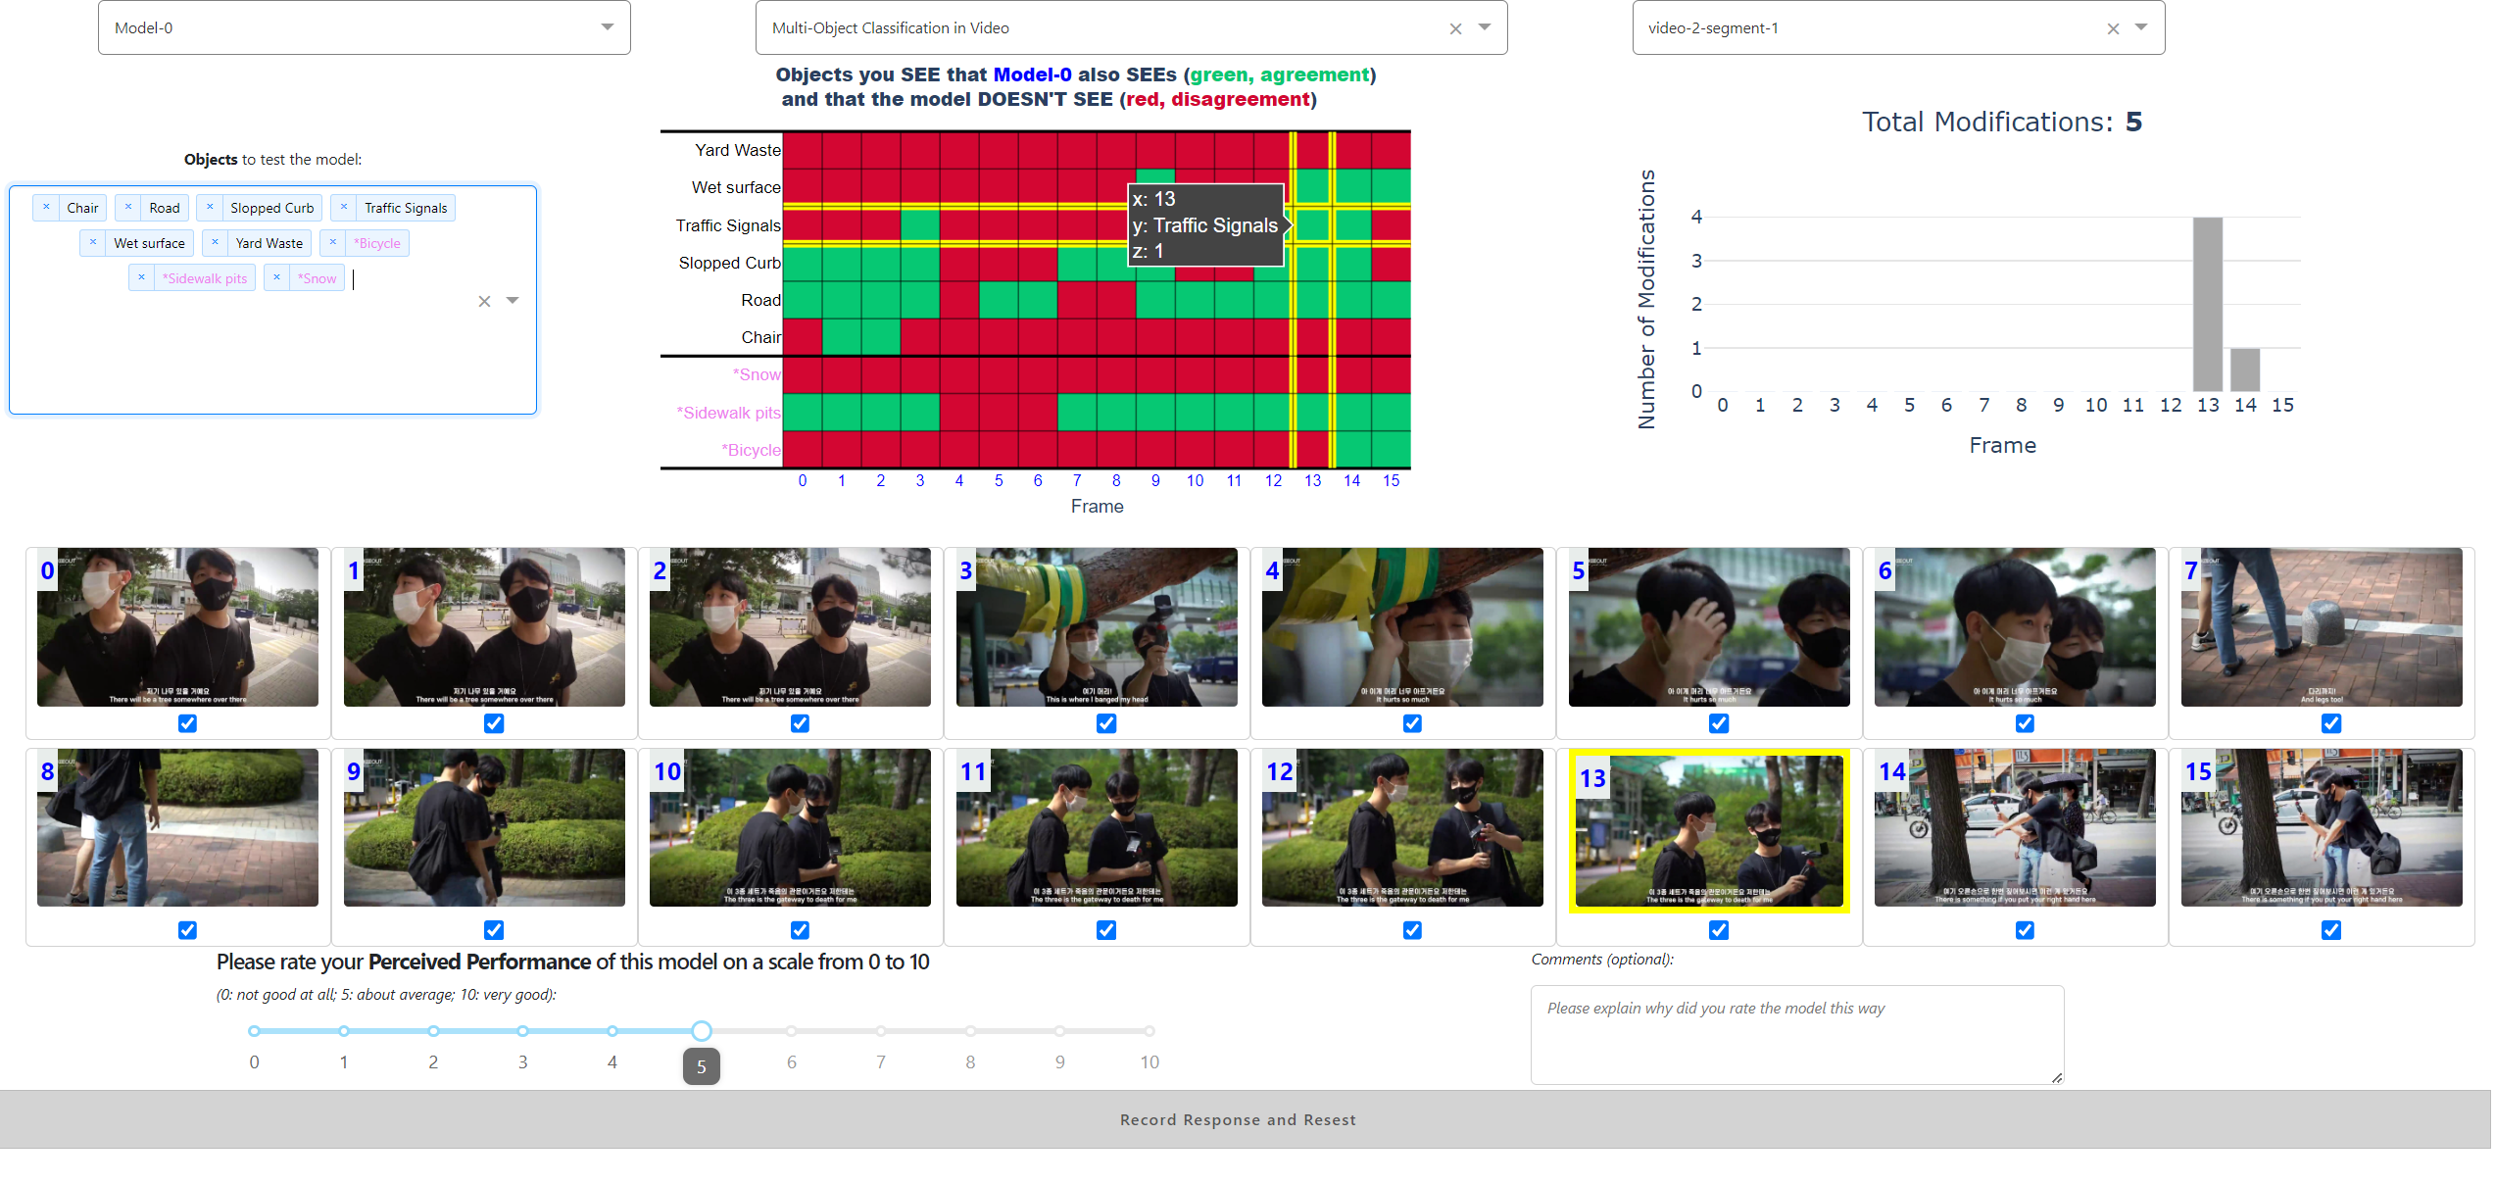
A
B
C
F
E
D
G
H
I
J

